Slide 1


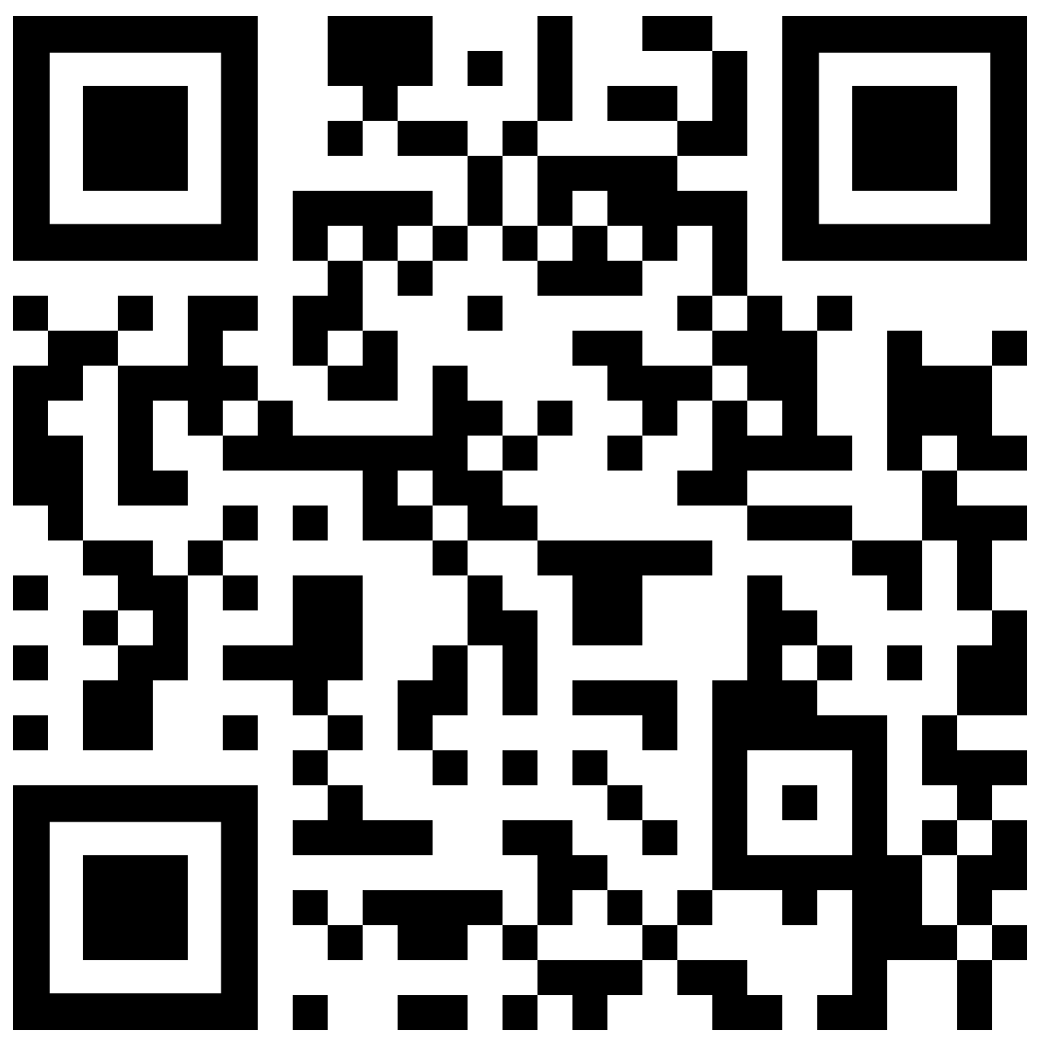
A Guide for Vascular Surgery Trainees Experiencing
Sexual Harassment
WHICH BEHAVIOURS ARE CONSIDERED SEXUAL HARASSMENT?
WHEN DOES IT CONSTITUTE SEXUAL HARASSMENT?
Behaviour can be unwanted even if you previously did not object to it
SEXUAL HARASSMENT
If it violates your dignity, makes you feel humiliated, degraded or intimidated
If it creates a hostile of offensive environment
Unfavourable treatment of the victim after reacting to sexual harassment counts as harassment and is against the law
Sexual Comments/ Jokes
SEXUAL ASSAULT
Displaying/sending sexual content
Coercion or force into unwanted sex
It is against the law for you to be victimized because you have made a complaint about sexual harassment
Touching another person sexually without their consent
Unwelcome Sexual Advances
WHERE TO SEEK SUPPORT ?
Friends, Family, trusted colleagues
Equality Advisory Support Service
Equality and Human Rights Commission
Rights of Women
BMA
ACAS
Samaritans
LGBT Foundation
Rape crisis helpline
Freedom to Speak Guardian
Speak Up helpline
Protect – National Charity
RCS
NHS Employers
GMC
WHAT CAN YOU DO ?
Sexual assault and Rape are a CRIME
RECORD what happened. Be specific and note witnesses. Secret recording may not always be legal
SPEAK UP If you feel comfortable, confront the perpetrator and ask them to STOP
REPORT IT to their line manager, your AES, TPD, head of department, HR, medical director, Postgraduate dean, SAC Rep, GMC, or CQC
ESCALATE If internal processes have not addressed the problem consider contacting the police if or bringing the issue to the public
Behaviour can be unwanted even if you did not ask it to STOP
www.citizensadvice.org.uk, https://www.rcsed.ac.uk, https://www.legislation.gov.uk/ukpga/2010/15/contents, http://rouleauxclub.com/BUHsupport

